Slide 1
Workshop 4: Data Cleaning
Group 23
Anna Parisi & Rahma Ahmed

Slide 2
Data Cleaning
Dataset: IBM HR Analytics Employee Attrition & Performance
Attributes: Age, Distance from home, Environment satisfaction, Monthly
income and Years since last promotion
Predict: Job Involvement
Why we chose this workshop?
Dataset cleaning
Potential issues
Cleaning techniques

Slide 3
Data Cleaning
Potential Issues
Incomplete Values
Noisy Data
Inconsistent Data
Cleaning Techniques
Handling Missing Values
Smoothing Techniques
Data Cleaning as a Process

Slide 4
Handling Missing Values

Slide 5
Handling Missing Values
Ignore Tuple
Fill Manually
Use Global Constant
Use Attribute Mean
Use Tuple Class Attribute Mean
Use Probable Value
Unbiased
VS
Biased

Slide 6
Smoothing Techniques

Slide 7
Smoothing Techniques
For dealing with random errors or variance in a measured variable:
Binning: smooth a sorted data value by consulting the values around it
Regression: fit the data to a function
Clustering: organise similar values are into groups to highlight potential outliers

Slide 8
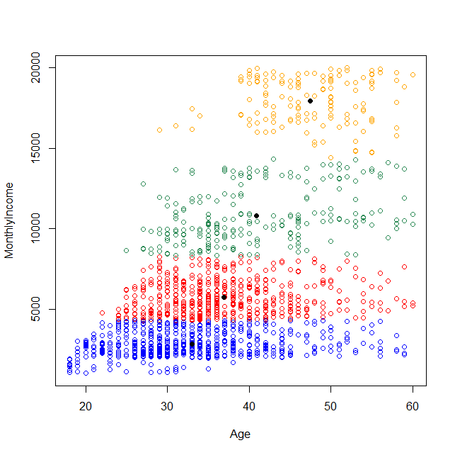
Clustering (1)
Initial attempt: k - means clustering
Clusters divide the data into zones
Very far from what we were expecting

Slide 9
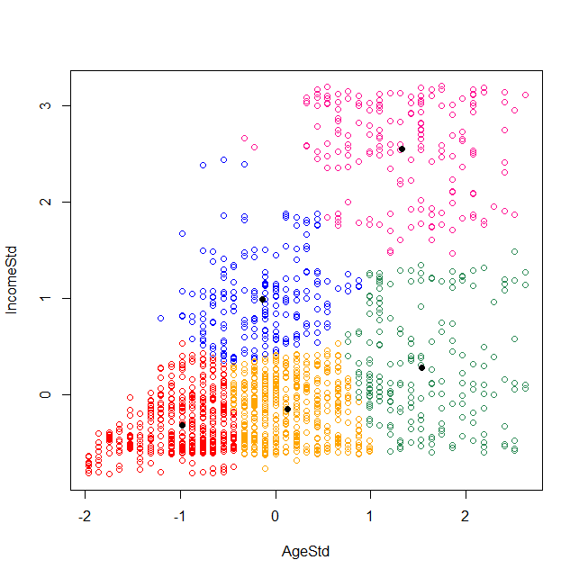

Clustering (2)
Final attempt: k - means clustering
Conversion to standard units
Result is a lot closer to what was expected and the graph makes sense

Slide 10
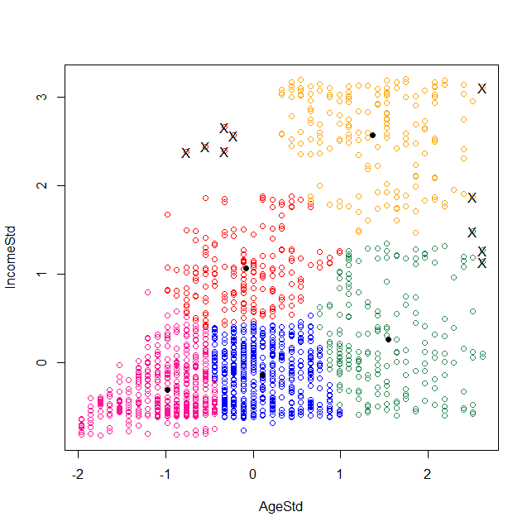
Outliers
All values has been assigned to a cluster
This highlights potential outliers
Calculate potential outliers

Slide 11
Data Cleaning
as a Process

Slide 12
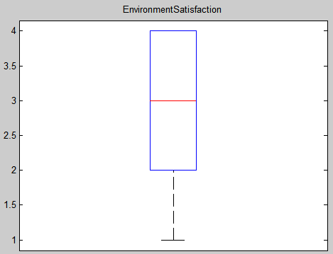
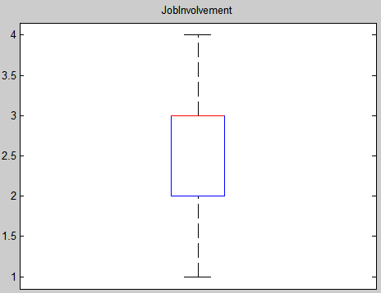
Data Cleaning as a Process
Discrepancy Detection
Use Metadata
E.g. Environment Satisfaction and Job Involvement attributes range [1-4]

Slide 13
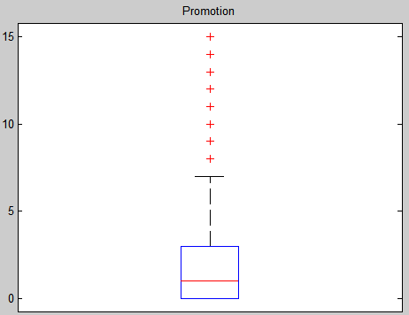
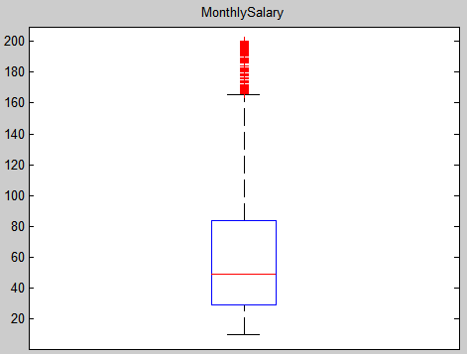
Data Cleaning as a Process
Discrepancy Detection
2. Identify Outliers
E.g. Years Since Last Promotion and Monthly Salary attributes.

Slide 14
Data Cleaning as a Process
Discrepancy Detection
3. Identify Inconsistent Data
4. Identify Field Overloading
5. Identify Rules: Unique, Consecutive and Null
Data Transformation
Changing the Data Format

Slide 15
Data Cleaning as a Process
Discrepancy Detection and Data Transformation Tools
Data Scrubbing tools
Data Auditing tools
Data Migration tools
ETL tools
Data Cleaning Tool Examples
Drake
OpenRefine
Data Wrangler
Winpure Data Cleaning Tool
Potter’s Wheel

Slide 16
Conclusion
Unexpected Findings
Our dataset was very clean to begin with: no missing values, very few outliers
The outliers highlighted by clustering were not extreme
The impact big differences in attribute scale can have
How intrusive data cleaning techniques are; can introduce a lot of bias
Cleaning the dataset gave us a deeper understanding of our data

Slide 17
Thank you for listening!

